Slide 1


HEP NTUA Weekly Report 30/9/2020
G. Bakas

Slide 2
Summary
Analysis:
Switched to Tune CP5 nominal MC’s for 2016
Start investigating ttbar Systematic Uncertainties
Investigate on how to combine the measurements between the three years
Combine them in the fiducial level and extract the cross section?
Extract the cross sections individually and combine the measurements in the unfolded level?
Top Angular Distributions: chi, |cosθ*| leading and subleading
Responses, Signal Extraction →Unfolding
Results!
AN 2020/156

Slide 3
Signal Selection
Control Region Selection
Variables | Selected Cut
pT (both leading jets) | > 400 GeV
Njets | > 1
N leptons | = 0
|eta| (both leading jets) | < 2.4
mJJ | > 1000 GeV
jetMassSoftDrop (only for fit) | (50,300) GeV
Top Tagger | > 0.2, 0, 0.1
B tagging (2 btagged jets) | > Medium WP
Signal Trigger
Variables | Selected Cut
pT (both leading jets) | > 400 GeV
Njets | > 1
N leptons | = 0
|eta| (both leading jets) | < 2.4
mJJ | > 1000 GeV
jetMassSoftDrop (only for fit) | (50,300) GeV
Top Tagger | > 0.2, 0, 0.1
B tagging (0 btagged jets) | < Medium WP
Control Trigger

Slide 4
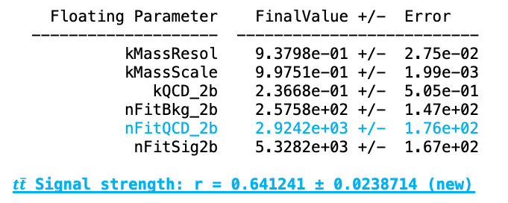
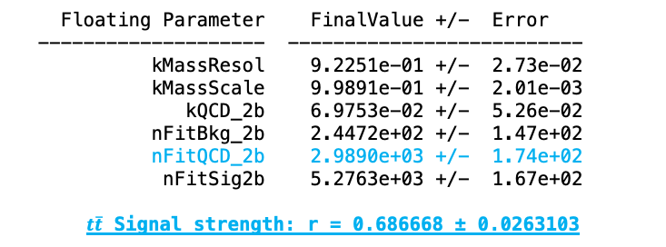
Mass Fit in Extended SR (SR_{A})
Both SR and Control Region use the Medium btag WP.
Intuition is to remove the ttbar and subdominant bkg contribution from the data Control Region
$$QCD_{0}\left(m^{t}\right)=D_{0}\left(m^{t}\right)−T_{0}\left(m^{t}\right)−Sub_{0}\left(m^{t}\right)$$
(2016)
Tune CUE
(2016)
Tune CP5
Floating Parameter FinalValue +/- Error
-------------------- --------------------------
kMassResol 9.2251e-01 +/- 2.73e-02
kMassScale 9.9891e-01 +/- 2.01e-03
kQCD_2b 6.9753e-02 +/- 5.26e-02
nFitBkg_2b 2.4472e+02 +/- 1.47e+02
nFitQCD_2b 2.9890e+03 +/- 1.74e+02
nFitSig2b 5.2763e+03 +/- 1.67e+02
$t\overline{t}$ Signal strength: r = 0.686668 ± 0.0263103
Floating Parameter FinalValue +/- Error
-------------------- --------------------------
kMassResol 9.3798e-01 +/- 2.75e-02
kMassScale 9.9751e-01 +/- 1.99e-03
kQCD_2b 2.3668e-01 +/- 5.05e-01
nFitBkg_2b 2.5758e+02 +/- 1.47e+02
nFitQCD_2b 2.9242e+03 +/- 1.76e+02
nFitSig2b 5.3282e+03 +/- 1.67e+02
$t\overline{t}$ Signal strength: r = 0.641241 ± 0.0238714 (new)

Slide 5
Fiducial Differential Cross Section
(2016)
(2017)
(2018)
(2016)
(2017)
(2018)

Slide 6
Fiducial Differential Cross Section Comparison
(2016)
(2017)
(2018)
(2018)
(2018)
(2016)
(2017)
(2018)

Slide 7
Fiducial Differential Cross Section Comparison
(2016)
(2016)
(2017)
(2017)
(2018)
(2018)
(2018)
(2016)
(2016)
(2017)
(2017)
(2018)

Slide 8
Parton Differential Cross Section
(2016)
(2016)
(2017)
(2018)
(2016)
(2017)
(2018)
(2016)
(2017)
(2018)

Slide 9
Parton Differential Cross Section Comparison
(2016)
(2016)
(2017)
(2017)
(2018)
(2018)
(2016)
(2017)
(2018)
(2018)
(2016)
(2017)

Slide 10
Parton Differential Cross Section Comparison
(2016)
(2016)
(2017)
(2017)
(2018)
(2018)
(2016)
(2017)
(2018)
(2018)
(2016)
(2017)

Slide 11
Tag And Probe Calculations
(2016) Tune CUE
(2016) Tune CP5
eff data: 0.781 ± 0.038
eff ttbar: 0.772 ± 0.014
-----------
Efficiency per Pt region
eff data pT[400-600]: 0.761 ± 0.042
eff ttbar pT[400-600]: 0.778 ± 0.016
-----------
eff data pT[600-800]: 0.851 ± 0.100
eff ttbar pT[600-800]: 0.748 ± 0.031
-----------
eff data pT[800-Inf]: 0.886 ± 0.160
eff ttbar pT[800-Inf]: 0.775 ± 0.063
eff data: 0.781 ± 0.038
eff ttbar: 0.813 ± 0.01
-----------
Efficiency per Pt region
eff data pT[400-600]: 0.761 ± 0.042
eff ttbar pT[400-600]: 0.812 ± 0.011
-----------
eff data pT[600-800]: 0.851 ± 0.100
eff ttbar pT[600-800]: 0.820 ± 0.023
-----------
eff data pT[800-Inf]: 0.886 ± 0.160
eff ttbar pT[800-Inf]: 0.806 ± 0.053

Slide 12
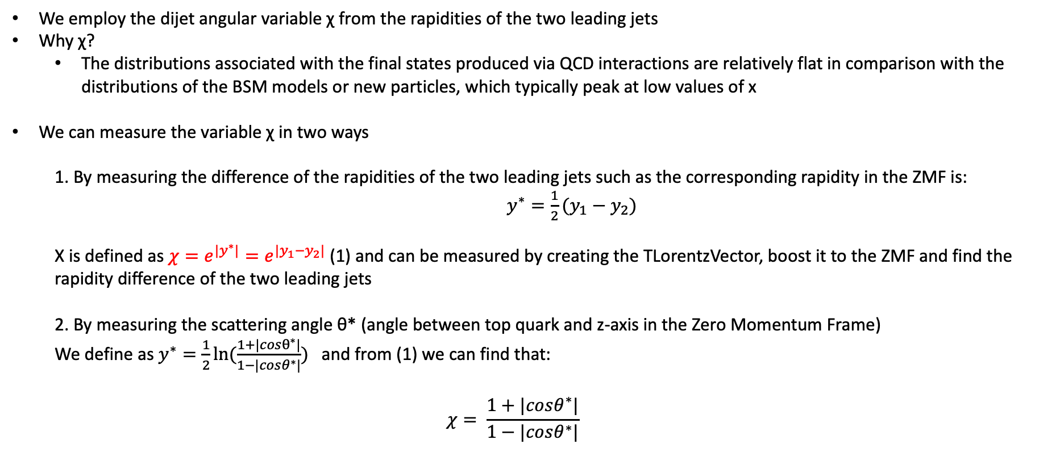
Top Angular Distributions
We employ the dijet angular variable χ from the rapidities of the two leading jets
Why χ?
The distributions associated with the final states produced via QCD interactions are relatively flat in comparison with the distributions of the BSM models or new particles, which typically peak at low values of x
We can measure the variable χ in two ways
1. By measuring the difference of the rapidities of the two leading jets such as the corresponding rapidity in the ZMF is: $y^{∗}=\frac{1}{2}(y_{1}−y_{2})$
Χ is defined as $χ=e^{{|y}^{∗}|}=e^{|y_{1}−y_{2}|}$ (1) and can be measured by creating the TLorentzVector, boost it to the ZMF and find the rapidity difference of the two leading jets
2. By measuring the scattering angle θ* (angle between top quark and z-axis in the Zero Momentum Frame)
We define as $y^{∗}=\frac{1}{2}ln⁡(\frac{1+|cosθ^{∗}|}{1−|cosθ^{∗}|})$ and from (1) we can find that:
$$χ= \frac{1+|cosθ^{∗}|}{1−|cosθ^{∗}|}$$

Slide 13
Efficiency, Acceptance

Slide 14
Response Matrices

Slide 15
Response Matrices

Slide 16
Signal Extraction
Fitted number of QCD events in SR_{A}
Measured dist from data
QCD shape taken from Data (CR)
$$S\left(x_{reco}\right)=D\left(x_{reco}\right)−C_{bkg}^{yield}N_{QCD}^{fit}C_{QCD}^{shape}\left(x_{reco}\right)Q\left(x_{reco}\right)−B(x_{reco})$$
Fiducial Yield
Transfer factor from SR_{A} to SR
QCD shape correction factor
Subdominant bkg shape and contribution (MC)
Where x_{reco} is the respected variable of interest (ttbar mass, pt, rapidity, leading and subleading jetPt and |jetY|)
We deploy a fit in the Signal Region (2btag) to extract the $N_{QCD}^{fit}$
$$D{\left(m^{t}\right)}^{(i)}=N_{tt}^{(i)}T^{(i)}\left(m^{t},k_{MassScale}, k_{MassResolution}\right)+N_{bkg}^{(i)}B\left(m^{t} \right)\left(1+k_{1}x\right)+N_{sub}^{(i)}O^{(i)}\left(m^{t}\right)$$
Our data CR is contaminated from ttbar and subdominant bkgs which has to be dealt with.

Slide 17
R yield

Slide 18
R yield

Slide 19
R yield

Slide 20
Fiducial Measurement
(2016)
(2017)
(2018)
(2016)
(2017)
(2018)

Slide 21
Fiducial Measurement
(2016)
(2017)
(2018)
(2018)
(2016)
(2017)

Slide 22
Fiducial Measurement
(2016)
(2017)
(2018)
(2016)
(2017)
(2018)

Slide 23
Parton Measurement
(2016)
(2017)
(2018)
(2016)
(2017)
(2018)

Slide 24
Parton Measurement
(2016)
(2017)
(2018)
(2016)
(2017)
(2018)

Slide 25
Parton Measurement
(2016)
(2017)
(2018)
(2016)
(2017)
(2018)

Slide 26
BACKUP

Slide 27
Signal Extraction
Fitted number of QCD events in SR_{A}
Measured dist from data
QCD shape taken from Data (CR)
$$S\left(x_{reco}\right)=D\left(x_{reco}\right)−C_{bkg}^{yield}N_{QCD}^{fit}C_{QCD}^{shape}\left(x_{reco}\right)Q\left(x_{reco}\right)−B(x_{reco})$$
Fiducial Yield
Transfer factor from SR_{A} to SR
QCD shape correction factor
Subdominant bkg shape and contribution (MC)
Where x_{reco} is the respected variable of interest (ttbar mass, pt, rapidity, leading and subleading jetPt and |jetY|)
We deploy a fit in the Signal Region (2btag) to extract the $N_{QCD}^{fit}$
$$D{\left(m^{t}\right)}^{(i)}=N_{tt}^{(i)}T^{(i)}\left(m^{t},k_{MassScale}, k_{MassResolution}\right)+N_{bkg}^{(i)}B\left(m^{t} \right)\left(1+k_{1}x\right)+N_{sub}^{(i)}O^{(i)}\left(m^{t}\right)$$
Our data CR is contaminated from ttbar and subdominant bkgs which has to be dealt with.

Slide 28
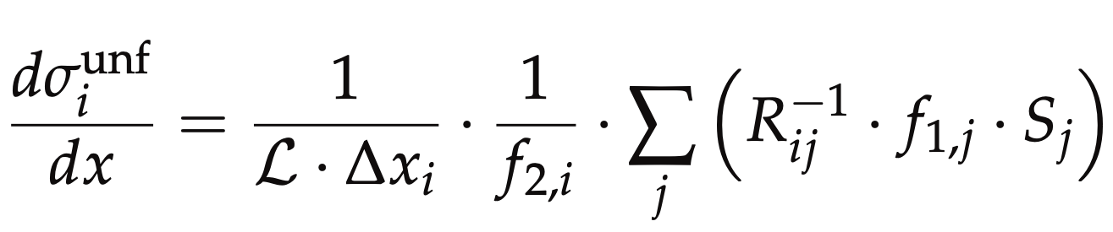
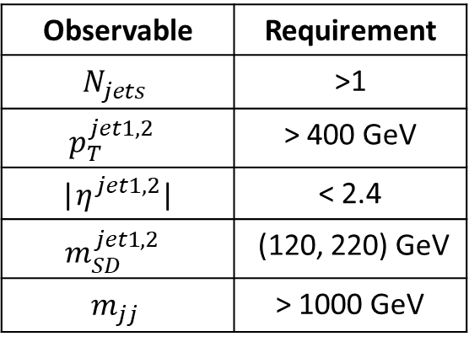
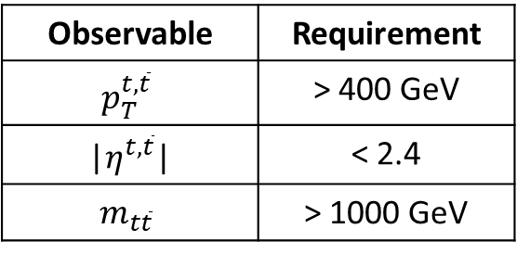
Parton & Particle levels
Particle level Top Candidates
Parton
Observable | Requirement
$$N_{jets}$$ | >1
$$p_{T}^{jet1, 2 }$$ | > 400 GeV
|$η^{jet1, 2}$| | < 2.4
$$m_{SD}^{jet1, 2 }$$ | (120, 220) GeV
$$m_{jj}$$ | > 1000 GeV
Observable | Requirement
$$p_{T}^{t,\overline{t}}$$ | > 400 GeV
|$η^{t,\overline{t}}$| | < 2.4
$$m_{t\overline{t}}$$ | > 1000 GeV
Parton Phase space
Reco/Fiducial Phase space
efficiency of the reco+true selection
reco efficiency of the reco+true selection
migration matrix
Unfolding: simple response matrix inversion w/o regularisation

Slide 29
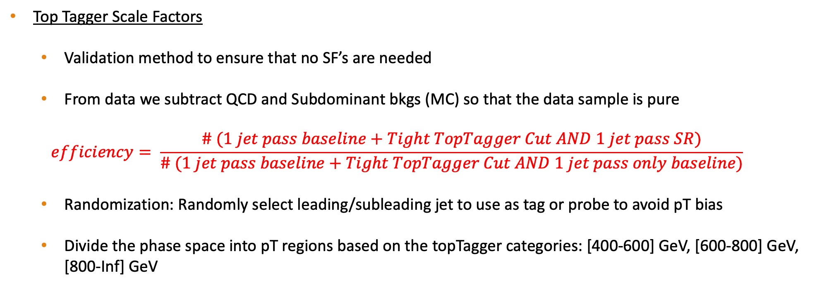
Tag And Probe
Top Tagger Scale Factors
Validation method to ensure that no SF’s are needed
From data we subtract QCD and Subdominant bkgs (MC) so that the data sample is pure
$$efficiency= \frac{\# (1 jet pass baseline+Tight TopTagger Cut AND 1 jet pass SR)}{\# (1 jet pass baseline+Tight TopTagger Cut AND 1 jet pass only baseline)}$$
Randomization: Randomly select leading/subleading jet to use as tag or probe to avoid pT bias
Divide the phase space into pT regions based on the topTagger categories: [400-600] GeV, [600-800] GeV, [800-Inf] GeV

Slide 30
Year | Type of File | DAS
2016 | TT Mtt 700-1000 | /TT_Mtt-700to1000_TuneCUETP8M2T4_13TeV-powheg-pythia8/RunIISummer16MiniAODv3-PUMoriond17_94X_mcRun2_asymptotic_v3-v2/MINIAODSIM
 | TT Mtt 1000-Inf | /TT_Mtt-1000toInf_TuneCUETP8M2T4_13TeV-powheg-pythia8/RunIISummer16MiniAODv3-PUMoriond17_94X_mcRun2_asymptotic_v3-v2/MINIAODSIM
 | TT Nominal | /TT_TuneCUETP8M2T4_13TeV-powheg-pythia8/RunIISummer16MiniAODv3-PUMoriond17_94X_mcRun2_asymptotic_v3-v1/MINIAODSIM
2017 | TT Mtt 700-1000 | --
 | TT Mtt 1000-Inf | --
 | TT Nominal Hadronic | /TTToHadronic_TuneCP5_13TeV-powheg-pythia8/RunIIFall17MiniAODv2-PU2017_12Apr2018_94X_mc2017_realistic_v14-v1/MINIAODSIM
 | TT Nominal Semilepton | /TTToSemiLeptonic_TuneCP5_13TeV-powheg-pythia8/RunIIFall17MiniAODv2-PU2017_12Apr2018_94X_mc2017_realistic_v14-v2/MINIAODSIM
 | TT Nominal Dilepton | TTTo2L2Nu_TuneCP5_13TeV-powheg-pythia8/RunIIFall17MiniAODv2-PU2017_12Apr2018_94X_mc2017_realistic_v14-v2/MINIAODSIM
2018 | TT Mtt 700-1000 | --
 | TT Mtt 1000-Inf | --
 | TT Nominal Hadronic | /TTToHadronic_TuneCP5_13TeV-powheg-pythia8/RunIIAutumn18MiniAOD-102X_upgrade2018_realistic_v15-v1/MINIAODSIM
 | TT Nominal Semilepton | /TTToSemiLeptonic_TuneCP5_13TeV-powheg-pythia8/RunIIAutumn18MiniAOD-102X_upgrade2018_realistic_v15-v1/MINIAODSIM
 | TT Nominal Dilepton | /TTTo2L2Nu_TuneCP5_13TeV-powheg-pythia8/RunIIAutumn18MiniAOD-102X_upgrade2018_realistic_v15-v1/MINIAODSIM
BACKUP SLIDES

Slide 31
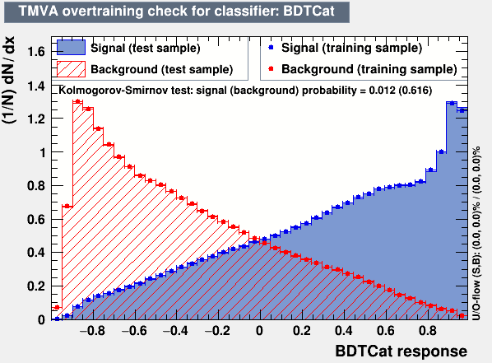
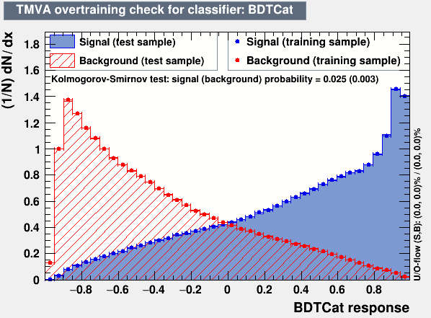
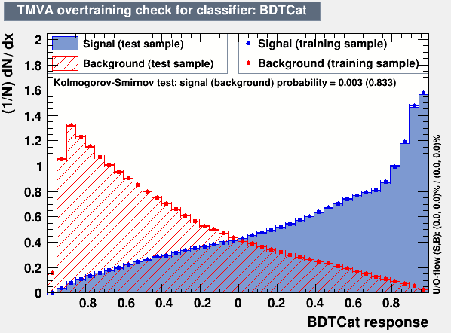
Overview: Discriminator, Efficiency and Acceptance
2016
The discriminator is a BDT trained individually for 2016, 2017 and 2018
Category training: split the sample in categories based on Pt
Bins:
[400, 600] GeV
[600, 800] GeV
[800, 1200] GeV
[1200, inf) GeV
BDT, used variables:
Leading and Sub-leading subjet mass
N-Subjetiness variables (tau1, tau2, tau3)
fraction of the jetPt over the total pt sum of the event.
Energy correlation functions (ecfB1N2,ecfB1N3, ecfB2N2, ecfB2N3)
BDT Output consistency for the 3 years
Calculation of Efficiency and acceptance for each year
We choose the WP’s for each year so that the leading jet p_{T} efficiency is similar for all years
2017
2018

Slide 32
Fit Params Results Comparison

Slide 33
Tight TopTagger + SR TopTagger
TagAndProbe Efficiency Plots
To scale the ttbar → fit the leading jetMassSoftDrop in each of these regions (ttbar compatible ~ with SR)
Tight TopTagger + Probe

